Slide 1
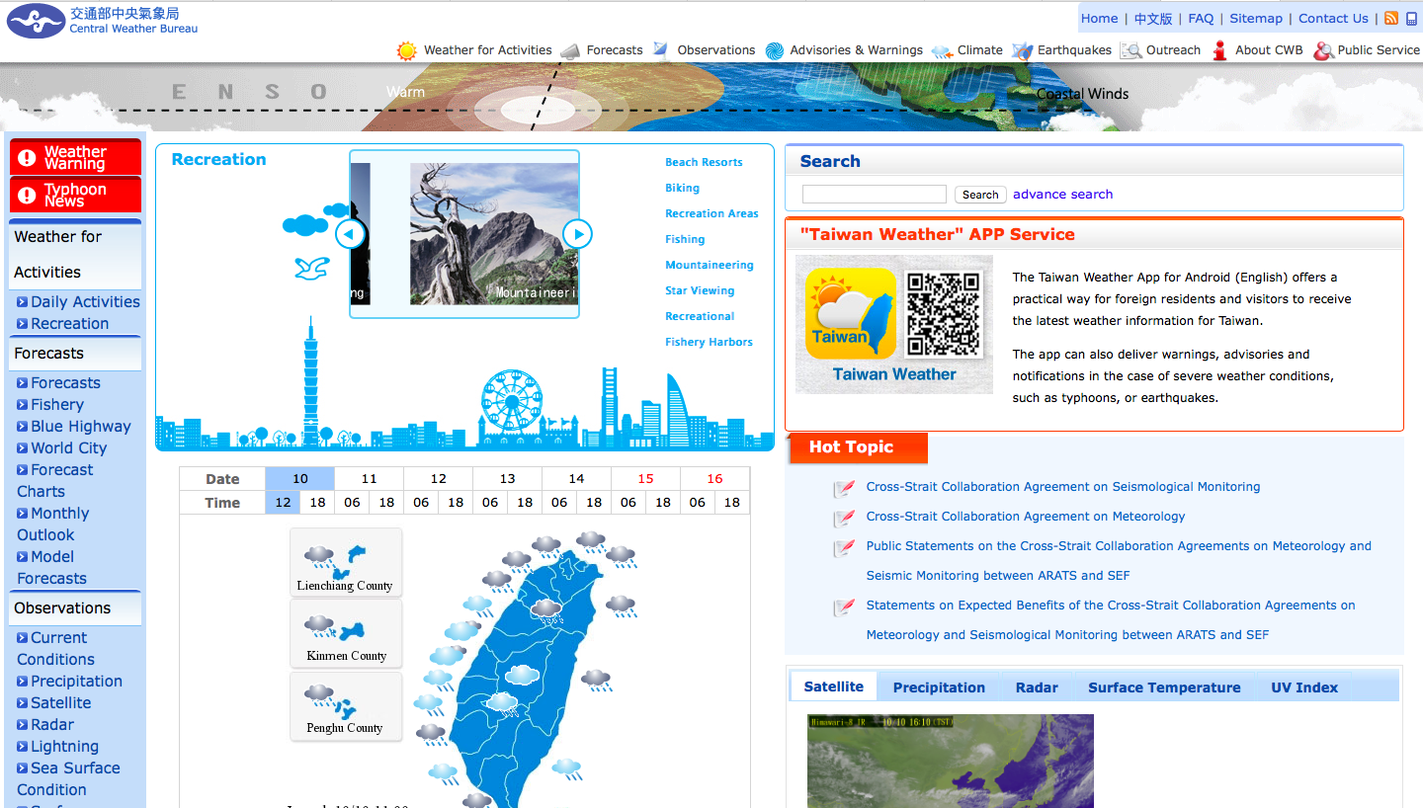
Weather for activities
Advisories & Warnings
warning
Forecasts
Satellite map
Taiwan’s
weather
Surface Temp.
UV index
Satellite map

